Slide 1
Clicks to Code Series
“Data Loaders”

Slide 2
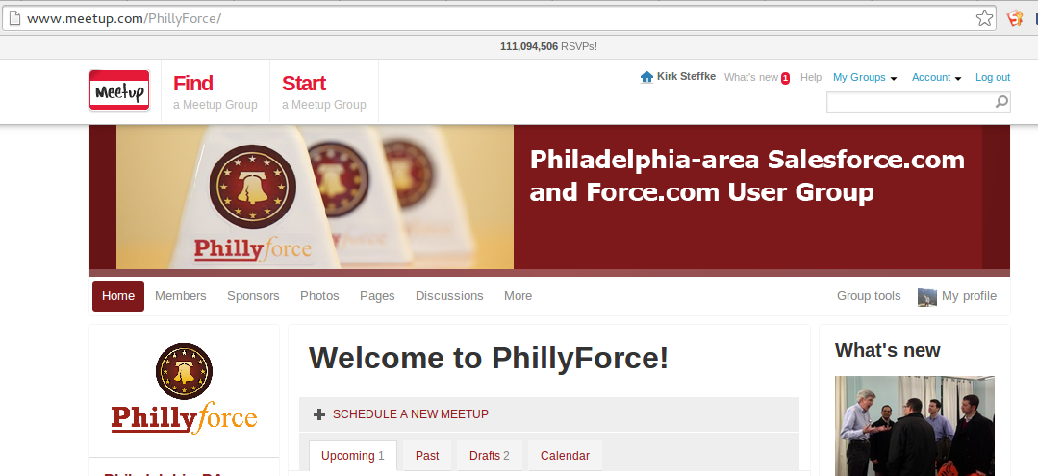
meetup.com/PhillyForce

Slide 3
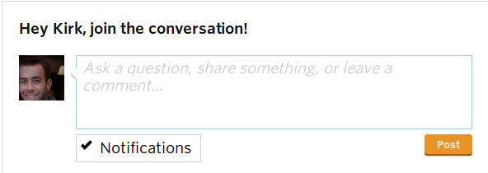
Continue the Conversation
Comment on tonight’s event:

Slide 4
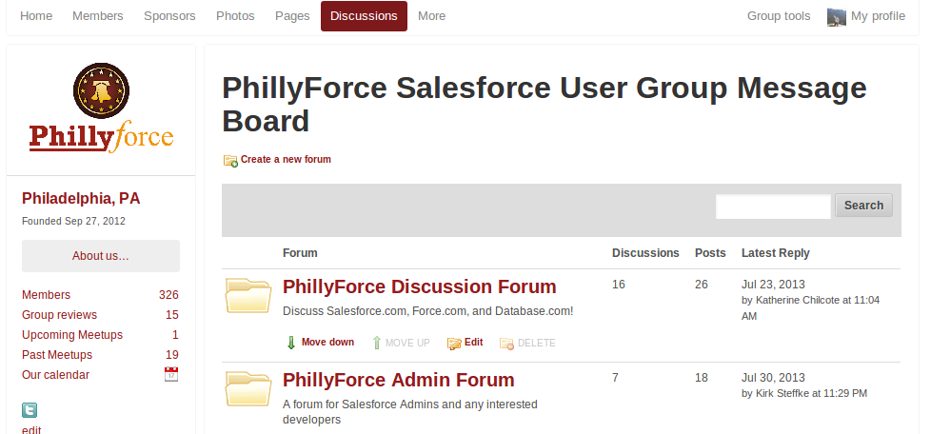
Discussions

Slide 5
A Special Thanks...
Website: www.liquidhub.com
Phone: (610) 945-2000
Address: 500 E. Swedesford Road
Suite 300
Wayne, PA 19087
Twitter: @LiquidHub
Wireless:

Slide 6
Meet the Team
Buyan Thyagarajan Eigen X
Mario Paes Eigen X
Christian Belko CRM Science, Inc

Slide 7
Tonight’s Agenda
What is Data Loader?
One Time Data Loads
Recurring Data Loads
Jitterbit
When to use what tools
Preventing problems with data loads
Questions

Slide 8
Clicks to Code Series
“Data Loaders”

Slide 9
What is the Data Loader?
The Data Loader is an easy to use graphical tool that helps you to get your data into Salesforce objects.
Can be downloaded by going to Setup | Administer | Data Management | Data Loader.
Allows you to Insert, Update, Upsert, Delete, Export, and Export All data from a connected Salesforce org.

Slide 10
Features of Salesforce Data Loader
An easy-to-use wizard interface
An alternate command line interface
A batch mode interface with database connectivity
Support for large files with up to millions of rows
Drag-and-drop field mapping
Support for all objects, including custom objects
Detailed success and error log files in CSV format
A built-in CSV file viewer
Official Mac Data Loader will be GA with Summer ‘15 release!

Slide 11
Reasons to Use Data Loader
You need to load 50,000 to 5,000,000 records. Data Loader is supported for loads of up to 5 million records.
You need to load into an object that is not yet supported by the import wizards.
You want to schedule regular data loads, such as nightly imports.
You want to export your data for backup purposes.

Slide 12
One Time Data Loads
Consider your use case for a one-time data load (i.e.Can it be done with the Data Import Wizard?)
When ready, follow the three steps: Create your data file, prepare your data for import, and setup the data loader to process your file.
Let’s see a short demo on how this works!

Slide 13
Recurring Data Loads
Can be run from the Command Line to automate data updates (more on that later…)
Consider other data features: (i.e. Weekly Data Export, Saved Mapping, etc.)
Pro Tip: You can use an External Id to import related records to an object!

Slide 14
Jitterbit Data Loader
Installable application to manage the import and export of salesforce data
Basic scripting available to transform source data before loading
File shares, flat files, web services, salesforce, and other databases supported as source connections.
- Allows users to schedule operations to run
- Best use: repetitive data operations or light integration

Slide 15
John Smith – SFDC Admin
John smith who was in sales ops has taken a new responsibility of SFDC admin for his company .
Brand new Salesforce org.
Begins loading leads in his org.
Uses data import wizard and data loader to load the leads.

Slide 16
Loading accounts, contacts, opportunities and custom objects
New challenge of loading accounts, contacts, opportunities and custom objects from external system.
Data loader and import wizards falling short, taking too much time to load.
IT Team comes to rescue for testing and load
Uses Jitterbit, Talend to load the data.
Multiple uploads, Fixing issues.

Slide 17
Connect to external systems
New needs on integration with ERP system.
Batch and real time integration needs
Uses Informatica , Boomi and other systems.
High volume data load, frequency of data load, multiple systems need to be connected.
Costs, infrastructure dependency

Slide 18
Marketing needs
New needs on loading external vendor load files.
Lot of duplicates
uses excel, data loader to import data
Deduplication rules.
Data quality
Test it in full copy sandbox.

Slide 19
Other Data Loader Tools
Tool | Description | Pros | Cons
Import Wizards | Inbuilt Salesforce import wizards | Simple, de-duping capabilities | Time consuming, can only import
Data Import Wizard | updated, unified version of the separate Import Wizards | Upgraded Interface | Time consuming, can only import
dataloader.io | Supports imports, exports, deletes, and scheduling | Simple UI but very advanced, Cloud based | Free version is reasonably limited: only 1 Salesforce connection, no SFTP, 1 scheduled job only
Excel Connector | Add on to Excel. Allows you to upload and export data directly in and out of an excel sheet | Great for quick operations, Built inside Excel, Great for manipulating data | Simple functionality compared to others
Informatica Data Loader | Supports Scheduling, multiple source types, and transformation scripting | Best use: repetitive data operations or light integration | Not good for: quick one-off loads
Other Tools: Workbench, LexiLoader (Mac OSX), Talend

Slide 20
Prevent problems before data load
Check date format to match salesforce
Excel truncation of fields like zip code for leading zero’s
Plan to verify data loads using reports, views and show counts.
Split large input files to multiple small files
to avoid data locks
Check email fields for valid formats
Use 18 digit Salesforce Ids for updates/upserts
Picklist values should match salesforce data
Ensure that there is a data backup prior to load.

Slide 21
Prevent problems after data load
Test with reports on count of records loaded.
On bad data loads, have a roll back plan to deal with it.
Check for random samples on data load.
Run demand tools or data quality tools
to check for duplicates.
Run an impact analysis before deleting bad
data .
Verify rollup fields on parent object.

Slide 22
Questions?
Website: www.liquidhub.com
Phone: (610) 945-2000
Address: 500 E. Swedesford Road
Suite 300
Wayne, PA 19087
Twitter: @LiquidHub

